Slide 1
Clinical Decision Support System for Hospital Discharge Decision Making James C. Cox Noah Langdale Jr Chair in Economics Georgia Research Alliance Eminent Scholar Director, Experimental Economics Center Georgia State University

Slide 2
Our Relevant Publications
Readmission and Discharge Decision Making research reported in:
Kassin, Owen, Perez, Leeds, Cox, Schnier, Sadiraj & Sweeney, “Risk Factors for 30-Day Hospital Readmission among General Surgery Patients”, Journal of the American College of Surgeons, 215(3), 2012, 322-330.
Leeds, Sadiraj, Cox, Schnier & Sweeney, “Assessing Clinical Discharge Data Preferences among Practicing Surgeons”, Journal of Surgical Research, 184, 2013, 42-48.
Leeds, Sadiraj, Cox, Gao, Pawlik, Schnier, Sweeney. “Discharge Decision-making after Complex Surgery: Surgeon Behaviors Compared to Predictive Modeling to Reduce Surgical Readmissions”, American Journal of Surgery, in press.
Experiments with the alpha CDSS reported in:
Cox, Sadiraj, Schnier & Sweeney, “Higher Quality and Lower Cost from Improving Hospital Discharge Decision Making”, Journal of Economic Behavior and Organization, in press.
Cox, Sadiraj, Schnier & Sweeney, “Incentivizing Cost-Effective Reductions in Hospital Readmission Rates”, Journal of Economic Behavior and Organization, in press.

Slide 3
Our Topic
Develop and Test Clinical Decision Support System (CDSS) that can
Decrease 30-day unplanned readmission rates and/or
Decrease average length of hospital stay

Slide 4
Research Protocol
Extract a large sample of (de-identified) patient data from the data warehouse of Emory University Hospital
Develop a predictive model of 30-day readmission
Develop a first (alpha) version of a Clinical Decision Support System (CDSS) based on model’s predictions
Conduct laboratory experiments to test uptake of the alpha CDSS under alternative information and compensation treatments
Develop a SMART on FHIR application for the CDSS that can interact with electronic health records in real time
Test efficacy of the SMART on FHIR application with a hospital ward intervention

Slide 5
CDSS for Discharge Decision Making
Uses time-varying predictive model to make recommendations
Target readmission rates:10% reduction from historical
Recommendations:
If point estimate is above target: “Do Not Discharge”
If point estimate is below target but upper 80% CI is not: “Physician Judgment”
If whole 80% CI is below target: “Discharge”
Graphically illustrates additional information:
Time-varying readmission probability prediction
Dynamically-updated “key” variables with time trends and “normal” range bands

Slide 6
Alpha Decision Support Software Screens

Slide 7
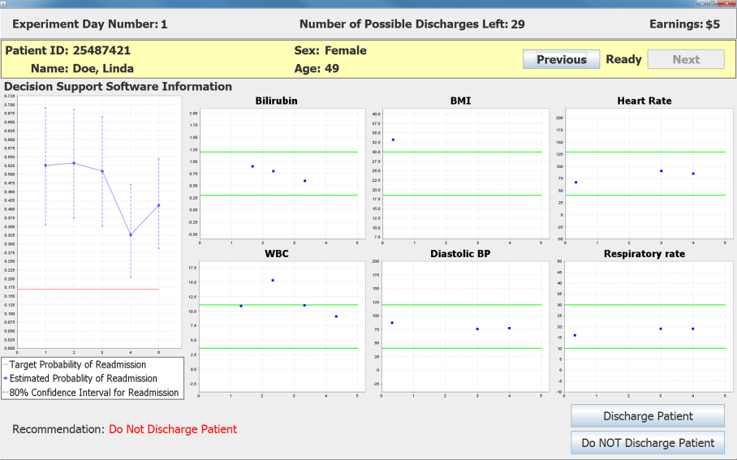
Recommendation: Do Not Discharge

Slide 8
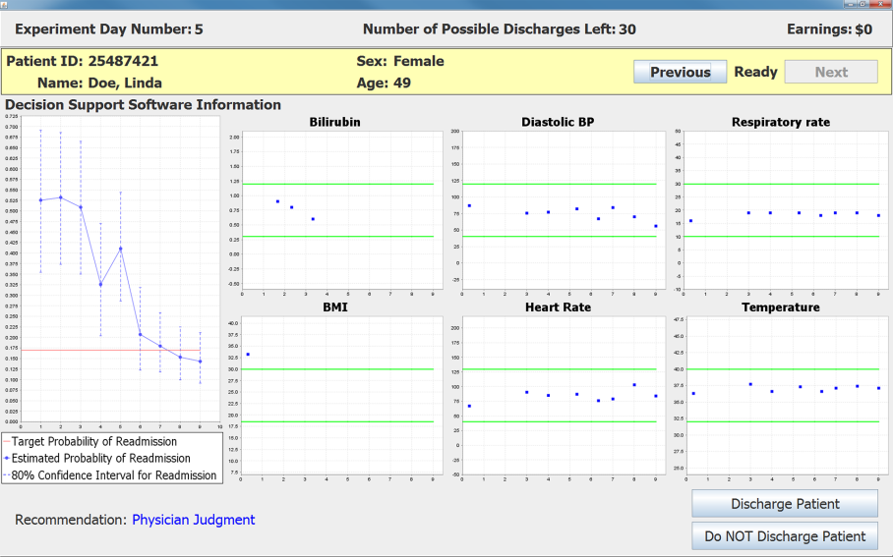
“Recommendation”: Physician Judgment

Slide 9
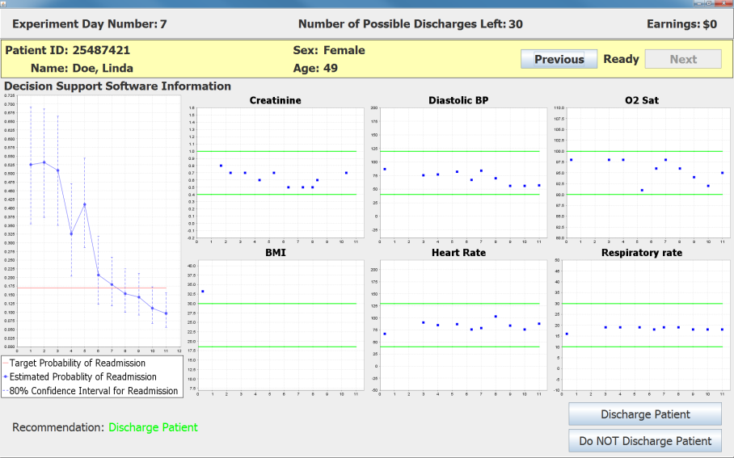
Recommendation: Discharge Patient

Slide 10
Summary Results from Laboratory Experiment
Subjects: resident physicians and medical students (4th yr.)
Focus: gastrointestinal surgery
Use of the alpha CDSS combined with a change in the default option
Reduces average length of stay
Reduces probability of readmission for high-risk patients

Slide 11
SMART ON FHIR Decision Support Software in Development

Slide 12
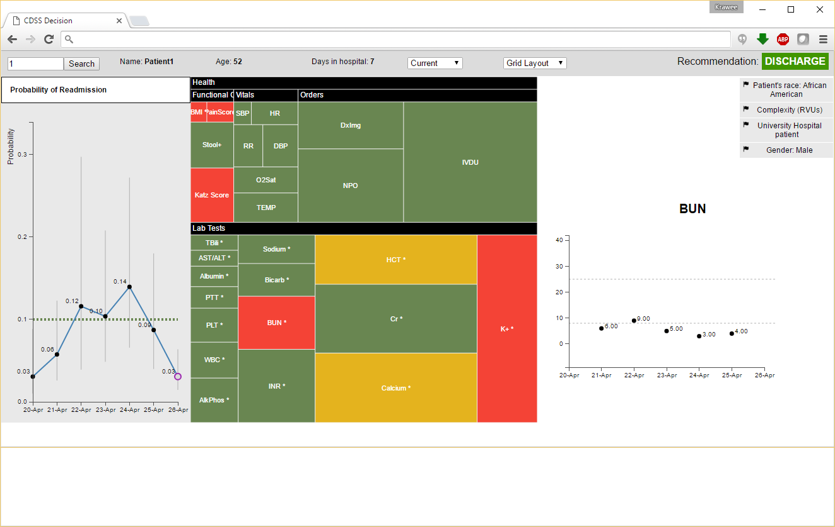
Rectangular Block Display

Slide 13
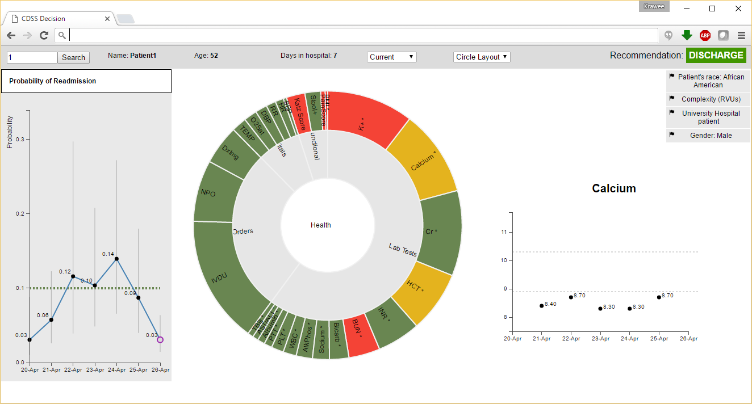
Circular Display

Slide 14
Thank you

